Slide 1
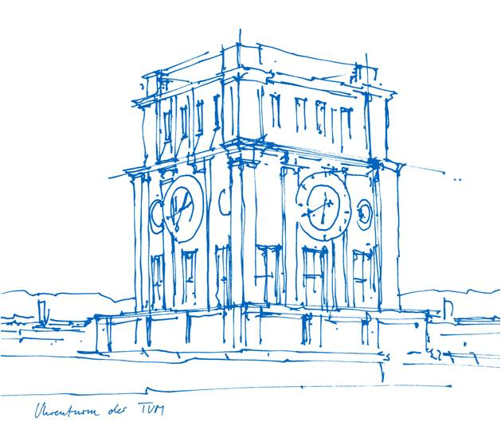
Autonomous Systems Sub-Terrain Challenge Group 20
PROJECT PRESENTATION
5th Reha Oguz Uslu Aerospace TUM Munich, Germany reha.uslu@tum.de
1st Alp Cankaya Aerospace TUM Munich, Germany go73juh@mytum.de
2nd Can Uludogan Aerospace TUM Munich, Germany can.uludogan@tum.de
3rd Erdem Ekinci Aerospace TUM Munich, Germany erdem.ekinci@tum.de
4th Esra Kaplan Yılmaz Aerospace TUM Munich, Germany esra.kaplan@tum.de

Slide 2
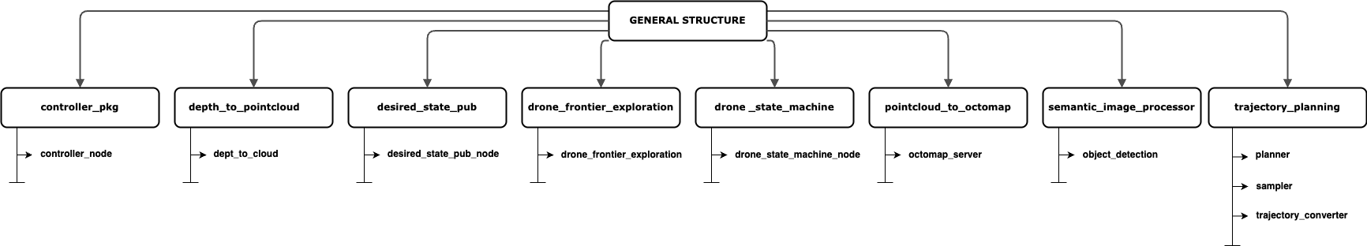
WORKSPACE STRUCTURE
Fig. 1: Workspace structure

Slide 3
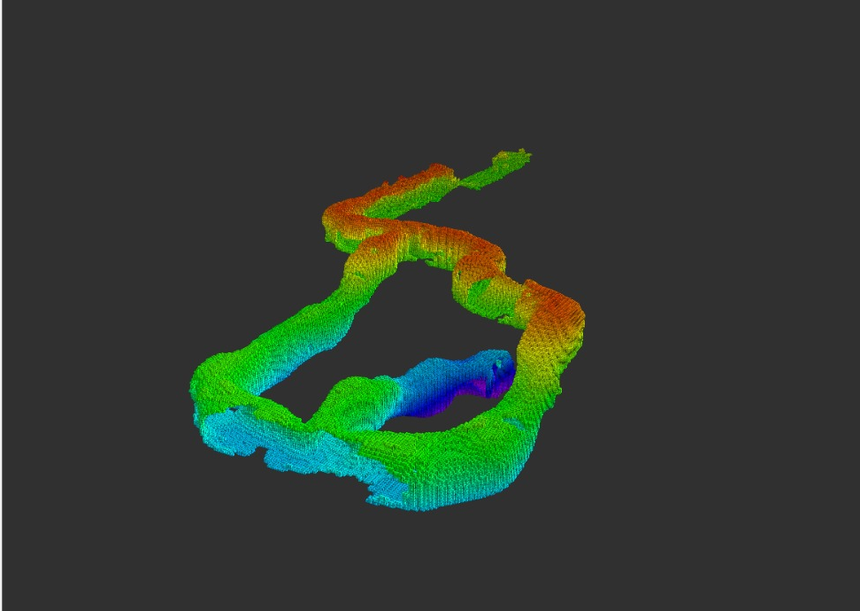
DESIRED STATE PUBLISHER
/desired_state_pub_node
Used for initial tests and trajectory detection until reaching the cave.
Only for manual control, not used in autonomous operation.
Arrow keys → Move in X-Y directions (Translation)
W / S → Increase / Decrease height
E / F → Rotate counterclockwise / clockwise
Node & Package Location:
Node Name: desired_state_pub_node
Package: desired_state_pub (in the source code folder)
Fig. 2 : The entire voxel grid of the cave.

Slide 4
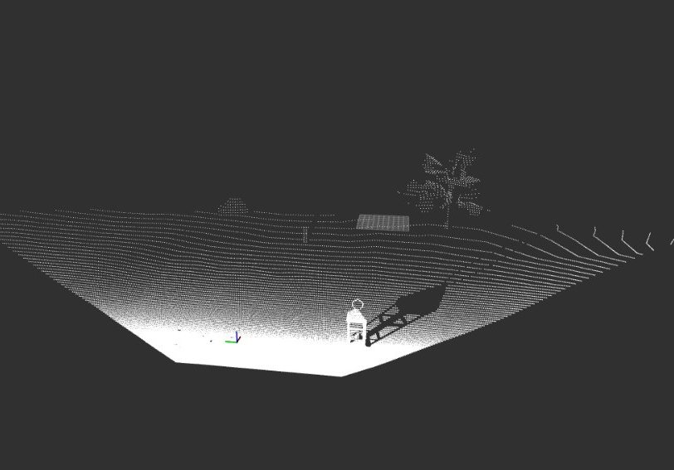
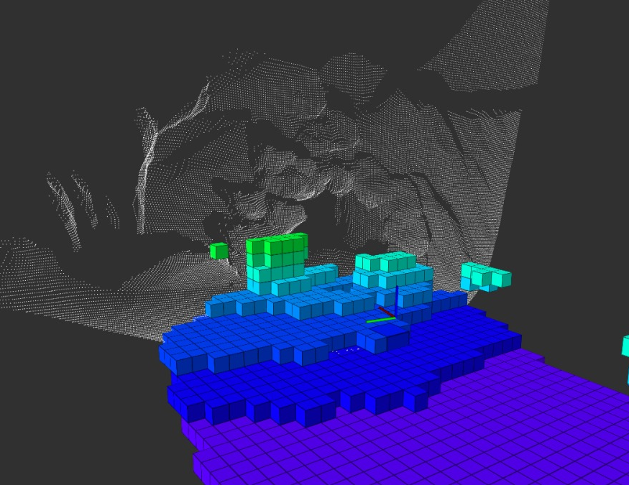
DEPTH IMAGE TO POINT CLOUD
/depth_to_pointcloud
The depth image output is used to generate a point cloud.
The /depth_to_cloud nodelet is an instantiation of the
/depth_image_proc/point_cloud_xyz nodelet, which is provided as a standard ROS package (pointcloud).
The instantiation is implemented in the depth_to_pointcloud package in the source code folder.
Fig. 3,4: Point cloud visualization

Slide 5
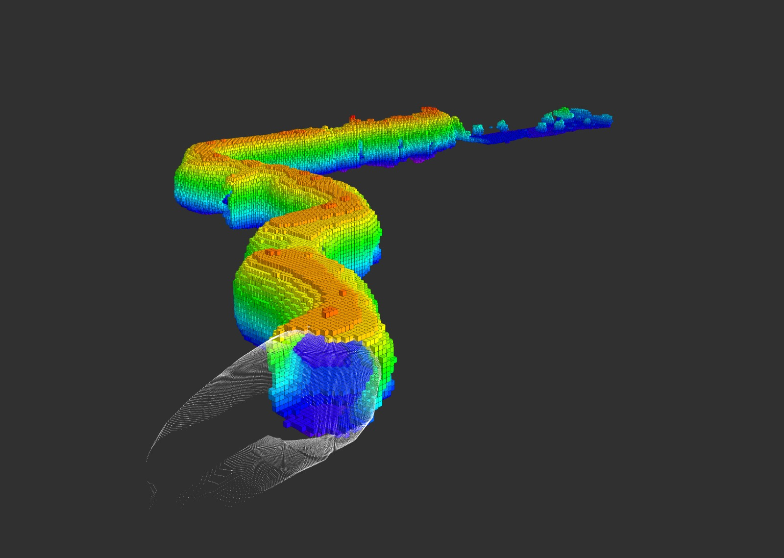
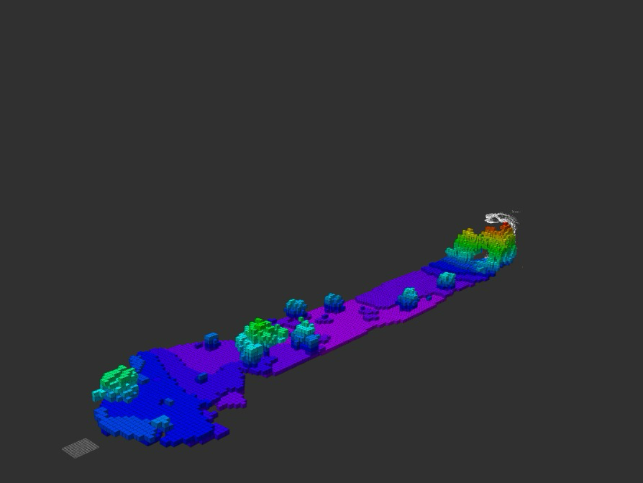
POINT CLOUD TO OCTOMAP
/octomap_server_node
The 3-D voxel grid representation is generated using the /octomap_server_node from the
octomap_server package (ROS standard package).
The launch file for this node is implemented in the pointcloud_to_octomap package in the source code folder.
The package subscribes to the /pointcloud topic and outputs the /occupied_cells_vis_array topic.
The 3-D voxel grid is visualized in RViz by selecting occupied_cells_vis_array as the MarkerArray topic.
Fig. 5,6: Octomap visualization

Slide 6

OBJECT DETECTION NODE
/object_detection
Detects and logs lantern positions in the world frame using the semantic_image_processor package and the semantic camera.
Identifies non-black pixels via OpenCV2 and randomly selects a batch.
Uses average depth of the selected pixels to compute object positions in the UAV body frame.
Logs objects with unique IDs if distance threshold is exceeded. The object positions, are saved in the object_positions.txt in the scripts folder of the package.
Publishes detected_objects_count – when count is 4, all objects are detected.
Fig. 7: Object in semantic camera

Slide 7
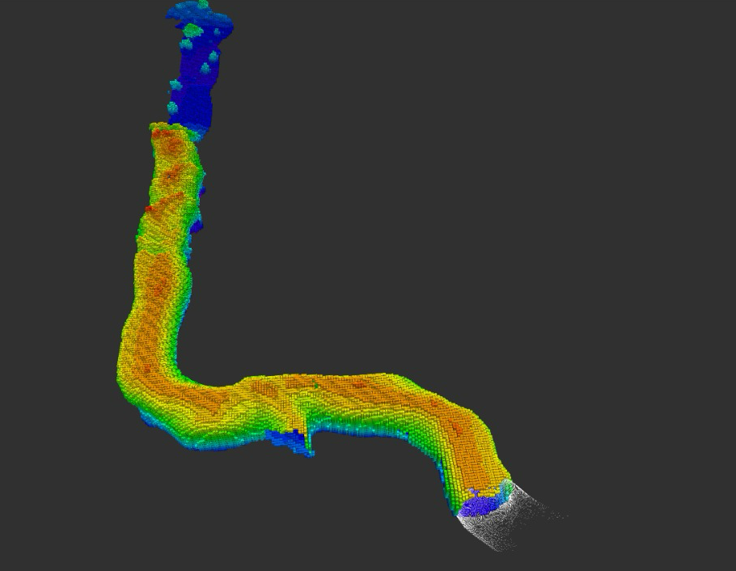
TRAJECTORY PLANNING NODE
/planner
Retrieves waypoints and velocity parameters from external sources (e.g., config/trajectory_config.yaml), algorithms (frontier detector)
Continuously listens to UAV state topic:
/current _state_est
Uses mav_trajectory_generation for trajectory generation in two modes:
Waypoint Following – Follows predefined waypoints from config/trajectory_config.yaml.
Goal-Based Motion – Activates when the UAV is within 1.5m of the cave entrance.
Reactively adjusts the trajectory based on sensor data.
Fig. 10: Trajectory planning

Slide 8
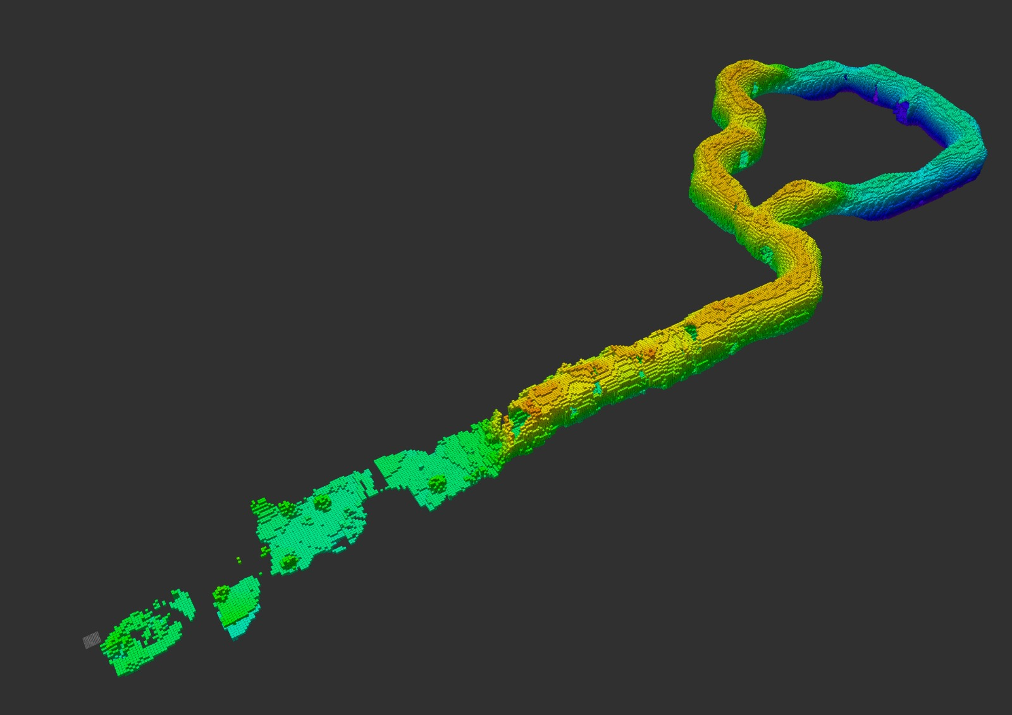
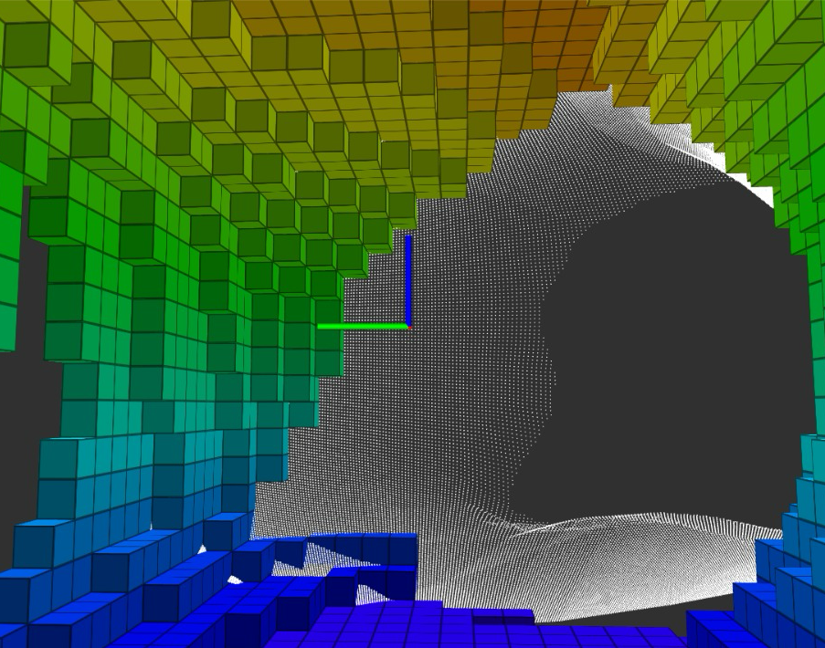
DRONE FRONTIER EXPLORATION NODE
/ drone_frontier_exploration
Implements frontier-based exploration using OctoMap for mapping the environment.
Subscribes to /true_body for the UAV's current position.
Subscribes to /octomap_full for the 3D environment map.
Identifies frontier points (boundaries between known and unknown space).
Selects the largest unexplored region and calculates the centroid as the next goal.
Publishes the goal to the Trajectory Planning Node via /goal_position for navigation.
Fig. 8,9: Frontier exploration

Slide 9
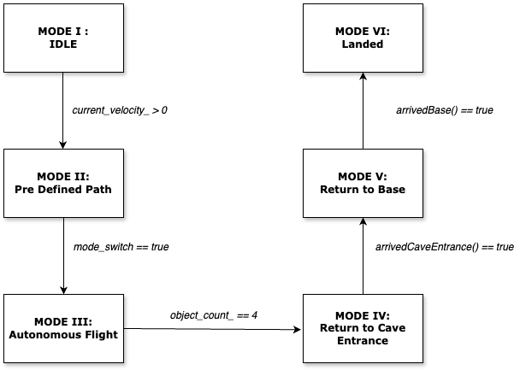
STATE MACHINE

Slide 10
Thanks for your attention!

